Slide 1
1.5” inlet = 1.75 sq in. 4 gpm = 4 x 231 cu in = 528 in/min = 8.8 in/sec
Two 1.5” inlets = 4.4 in/sec
24”
3”
Flute with eight 1” holes space 3” on center:
6.28 sq in. 4 gpm = 4 x 231 cu in = 147 in/min = 2.4 in/sec

Slide 2
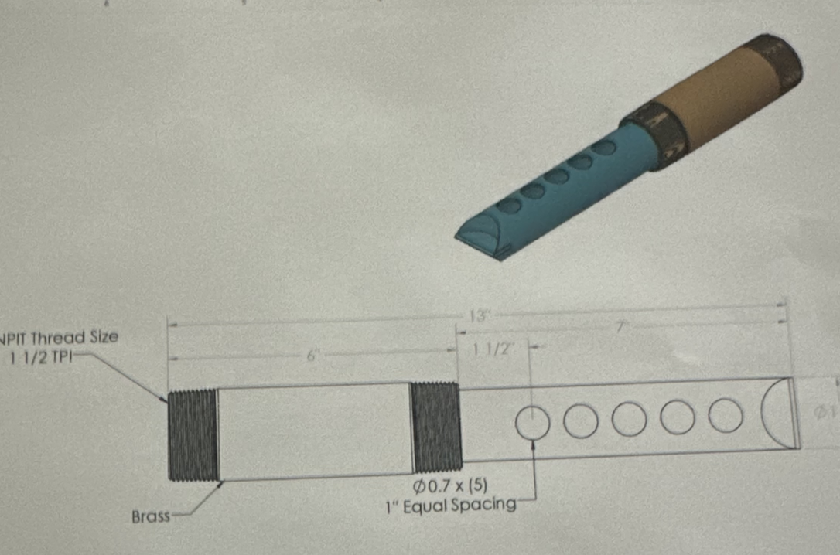
Option 1: (1) 1.5” inlet = 1.75 sq in.
Option 2: (2) 1.5” inlets = 3.5 sq in.
1.5”
1.5”
Option 3: Vaughn Flute = 1.9 sq in
(5) .7” holes = 1.9 sq in

Slide 3
Option 4: (1) 2” inlet = 3.14 sq in.
Option 5: (2) 2” inlets = 6.28 sq in.
2”
2”

Slide 4
Option 4: Moscone-made flute with 12 1” holes spaced 2” on center = 9.42 sq in
2”
1.5”
.75”
.75”
.75”
.75”
.875”
.875”
.875”
.875”
1”
1”
1”
1”
24”
Option 5: Moscone-made flute with 12 holes, increasing in size, spaced 2” on center = 7.31 sq in.
2”
1.5”
.75”
.75”
.75”
.75”
.875”
.875”
.875”
.875”
1”
1”
1”
1”
24”

